Slide 1

Introduction to the Microsoft Graph
Joon du Randt
@joon_net
Credit where it’s due… The content in this presentation is derived from this great series of blog posts:
https://developer.microsoft.com/en-us/graph/blogs/announcing-30-days-of-microsoft-graph-blog-series/
Notes:
Image credit: https://www.microsoft.com/developerblog/2017/09/28/data-independent-graphql-using-view-model-based-schemas/

Slide 2
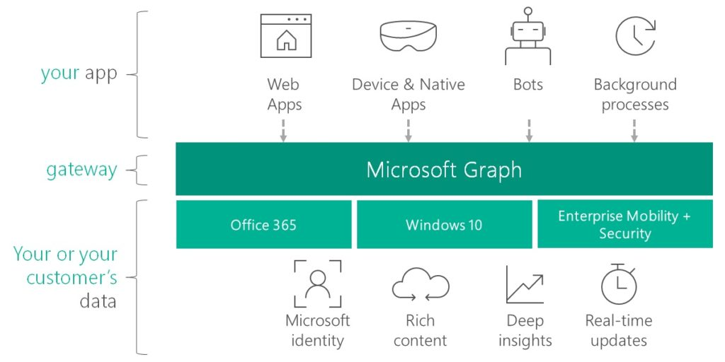
Where the graph API fits
Image credit: https://developer.microsoft.com/en-us/graph/blogs/30daysmsgraph-day-2-overview-microsoft-graph/

Slide 3

Why the MS Graph is important
It gives us one endpoint for accessing any data from all of these services:
Azure AD
Office365
Enterprise Mobility and Security
Windows 10 Services
Education
It provides a unified and modernized Security approach
https://xkcd.com/1369/

Slide 4

Introducing the Graph Explorer
Let’s load up the graph Explorer and try it out:
https://aka.ms/ge
Notes:
Sample queries - Basic
Log in with a tenant ID and see the differences
Sample Queries: Across Services
Selecting Fields
Paging
Limiting results: https://graph.microsoft.com/v1.0/users?$filter=startswith(userPrincipalName, 'Meg’)
Limiting fields: https://graph.microsoft.com/v1.0/users?$select=id,displayName
Limiting fields and results: https://graph.microsoft.com/v1.0/users?$select=id,displayName&$filter=mail eq 'MeganB@M365x214355.onmicrosoft.com’

Slide 5

Next up: Build a web part powered by the graph API

